Slide 1

A SEMINAR PRESENTATION
ON
“WASTE SEGREGATION SYSTEM”
PRESENTED BY
Roll No - Om Sanjay gujar
Guided By:
Prof.Dr.Mahendra Salunke
Academic Year:2024-2025
DEPARTMENT OF COMPUTER ENGINEERING
PIMPRI CHINCHWAD COLLEGE OF ENGINEERING & RESEARCH PUNE

Slide 2
INTRODUCTION
This paper presents a comprehensive overview of waste segregation using (IoT). Smart bins with many sensors, including moisture, infrared, and ultrasonic ones, connectivity elements like power supply and battery, make up the Internet of Things-based trash segregation system

Slide 3
LITERATURE SURVEY
Research article (Author/Year) | Objective/Proposed work | Methods/Techniques | Datasets/ supporting data | Relevant findings/ Limitations identified
El-Kanj, Hania (2023) | to design and implement a fully automated system | SWMS proposed design is to integrate sensors | Kaggle Datasets - IEEE Dataport - Open IoT Data | Other waste requires further segregation.
Pandey, Atul & Sahu(2019) | segregate waste at source then Recycling | segregate waste into 3 categories wet, dry and hazardous waste | DPCC MSW Govt. of Delhi ,Delhi. | Only applicable for developing countries ,plagued with weak institutions
Wirani, Yekti & Eitiveni(2024) | develop a smart and integrated household waste management | SLR PRISMA PICO | ISWM framework SLR technique, PRISMA | does not focus on diﬀerentiating between developing and developed countries

Slide 4
PROBLEM STATEMENT & OBJECTIVES
Problem Statement
Develop a system which can segregate hazardous hospital waste before disposal.
Objective
In recent times, the world has been experiencing an increase in medical cases due to inappropriate disposal of hospital waste.To properly segregate Hazardous wastes in medical facilities.

Slide 5
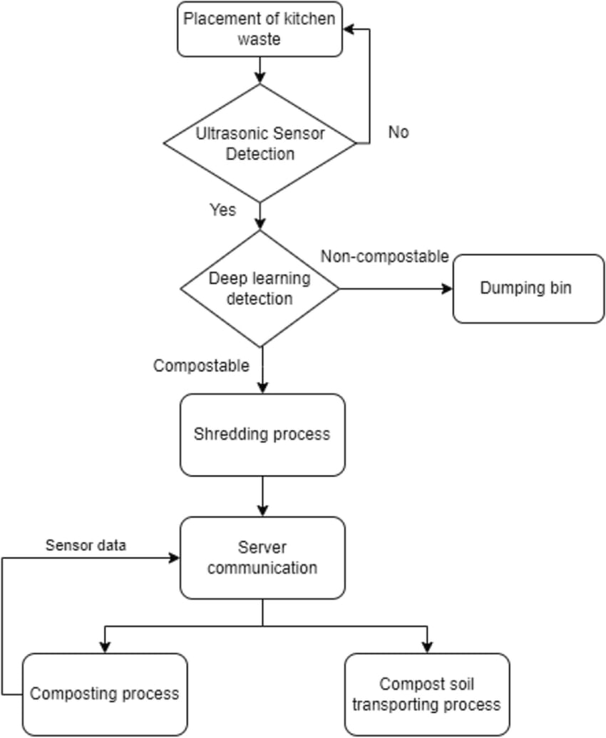
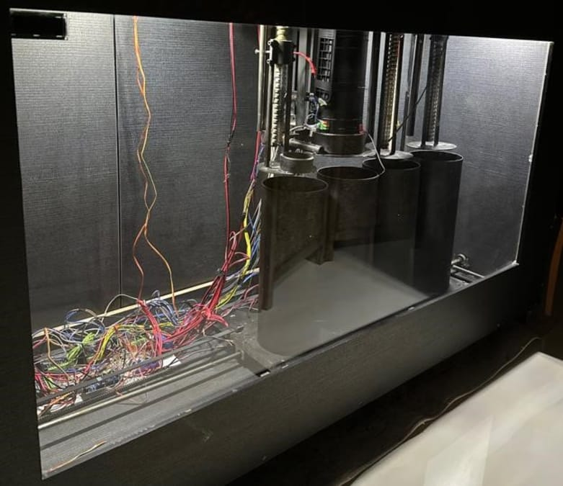
EXISTING SYSTEM

Slide 6
EXISTING SYSTEM
this project proposes an intelligent kitchen waste composting system via deep learning and Internet-of-Things (IoT) that is fully automated to cater for that issue. Firstly, the proposed system utilized Convolutional Neural Network (CNN) to detect and segregate kitchen waste into compostable and non-compostable categories. Then, the classified compostable waste went through composting stage inside an automated compost bin with the feature of IoT. The IoT compost bin requires less human labor as it used sensors, actuators, and Wi-Fi connection to monitor and control the composting process. Finally, the compost soil is transferred to the designated gardening area via smart compost soil transportation system. The system consists of a robot equipped with infrared sensors. The sensors control the robot’s movement by tracking the predefined black tape path. A prototype is built to investigate the performance of the proposed system. Results show that each sub-system managed to interact with one another, thus creating a large intelligent system that succeeded in completing the kitchen waste segregation, composting and ready compost delivering tasks automatically.

Slide 7
PROPOSED SYSTEM
A Arduino board uses different capacitive sensor ultrasonic sensor and
also LED screen to implement the solution a its maximal
Ultrasonic Sensors: Measure the distance of waste within the bin, working with a servo motor to control the lid's opening and closing.
Camera Module: Attached to an Arduino UNO for waste image recognition and classification according to the bin colour.
Gas Sensor: Monitors gas levels within the bin, triggering an alert via a buzzer if the gas exceeds a predefined threshold, indicating the presence of hazardous fumes .
Buzzer: Alerts when the bin is filled to capacity.
GSM Module: Sends SMS alerts to frontline workers when bins are full or emitting foul odours

Slide 8
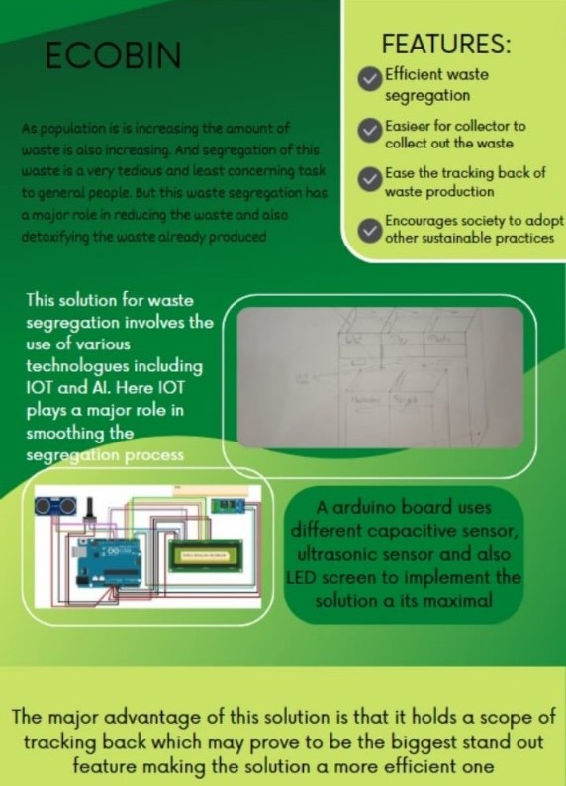

Slide 9
FEASIBILITY AND SCOPE
FEASIBILITY
The major advantage of this solution is that it holds a scope of tracking back which may prove to be the biggest stand out feature making the solution a more efficient one
SCOPE
Easy to install
Portable
Easy to develop as its base is already exist
Applicable for all the hospitals
Easy to maintain

Slide 10
CONCLUSION & FUTURE SCOPE
CONCLUSION
This IoT-enabled system ensures proper waste segregation, treatment, and disposal ,Enhancing safety for healthcare employees, patients, and the environment
FUTURE SCOPE
Efficient waste segregation
Easier for collector to collect out the waste
Ease the tracking back of waste production
Encourages society to adopt other sustainable practice

Slide 11
REFERENCES
Ramdoss Prabha and Venkatesh Ramani, “IoT based smart healthcare monitoring system using IOT component WSN.
Pandey, Atul & Sahu, Rohit & Tyagi, Ram. (2019). A RESEARCH STUDY ON WASTE SEGREGATION AT SOURCE IS THE KEY IN MUNICIPAL SOLID WASTE MANAGEMENT IN DELHI.
Hewagamage, Pasindu & Mihiranga, Amith & Perera, Dananjaya & Fernando, Rahul & Thilakarathna, Thusitha Anjana & Kasthurirathna, Dharshana. (2021). SMART Garbage Bin Kit: Expandable and Intelligent Waste Management System using Deep Learning and IoT for Modern Organizations. 165-170. 10.1109/ICter53630.2021.9774824.

Slide 12
Lim-Wavde, Kustini & Kauffman, Robert & Dawson, Gregory. (2017). Household informedness and policy analytics for the collection and recycling of household hazardous waste in California. Resources, Conservation and Recycling. 10.1016/j.resconrec.2016.10.007.
Goel, Sudha. (2008). Municipal solid waste management (MSWM) in India A critical review. Journal of environmental science & engineering. 50. 319-28.
Wirani, Yekti & Eitiveni, Imairi & Sucahyo, Yudho. (2024). Framework of Smart and Integrated Household Waste Management System: A Systematic Literature Review Using PRISMA. 10.20944/preprints202405.0297.v1.
El-Kanj, Hania & Abdulqader, Fawaz & Albannai, Abdullah & Alarbash, Abdulhamid & Aldaihani, Mansour. (2023). An IoT Based Smart Waste Management System with Built-in Segregation Feature.

Slide 13
Conference attended certificate/Survey paper acceptance letter /Copyright information

Slide 14
THANK YOU

